Slide 1
Predicting Fetal Anomalies Using Cardiotocography Data
A Data-Driven Approach for Early Detection
Gian Luca Nediani, gianluca.nediani@icloud.com

Slide 2
Introduction
Goal: Develop a model to identify potential fetal anomalies from Cardiotocography (CTG) data.
Relevance: Data-driven assistance in early detection of anomalies can support obstetricians and improve outcomes.

Slide 3
What is Cardiotocography (CTG)?
Definition: A non-invasive method to monitor fetal heart rate and uterine contractions.
Purpose: Assess fetal well-being and detect potential issues early.

Slide 4
Overview of the Dataset
Data source is the UC Irvine Machine Learning Respository
2126 examples
21 features all related fetal heart rate (FHR) and uterine contraction (UC).
3 Classification labels:
Normal, no apparent issues with the fetus.
Suspect, potential concerns that may require further examination.
Pathological, high likelihood of fetal anomalies that need urgent attention
Labeling done by three expert obstetricians by consensus.

Slide 5
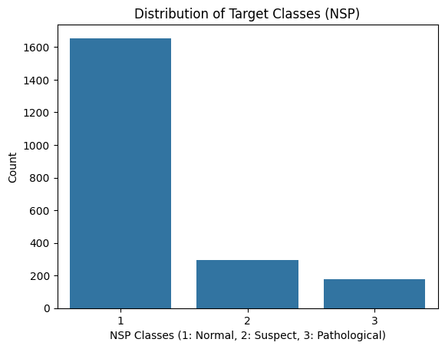
Data Exploration
Main challenge: class imbalance (most examples in the dataset represent “Normal” class).
Risk for the model of being biased towards predicting the majority class, potentially missing or misclassifying critical anomalies.

Slide 6
Data pre-processing
Data Cleaning: Handled missing values (none present in this dataset) and label format.
Splitting: Divided data into training and testing sets to evaluate model performance on unseen data
Scaling: Standardized features for consistent performance (after splitting to avoid data leakage).
Resampling: Balance class distribution by augmenting training set with synthetic data (using SMOTE).

Slide 7
Classification Model: XGBoost
Extreme Gradient Boosting (XGBoost): powerful and widely used machine learning algorithm for classification and regression tasks.
Iterative Learning with Weak Learners: Builds models sequentially, where each new decision tree (weak learner) corrects errors from previous trees, combining their outputs to enhance accuracy.
Built-in Feature Importance: Provides insights into the significance of each feature.
Handles Label Imbalance: Uses sampling weights to address class imbalance effectively.

Slide 8
Classification Model Choice:
Why XGBoost?
State-of-the-art performance on structured data (such as CPT).
Robust against overfitting (good for class imbalance scenario).
Efficiency means fast inference (practical for real-life use).
Why not Neural Networks (aka the Current Hot Trend)?:
Unnecessarily complex for the task at hand (structured numerical dataset)
Prone to overfitting
More computationally expensive and data hungry

Slide 9
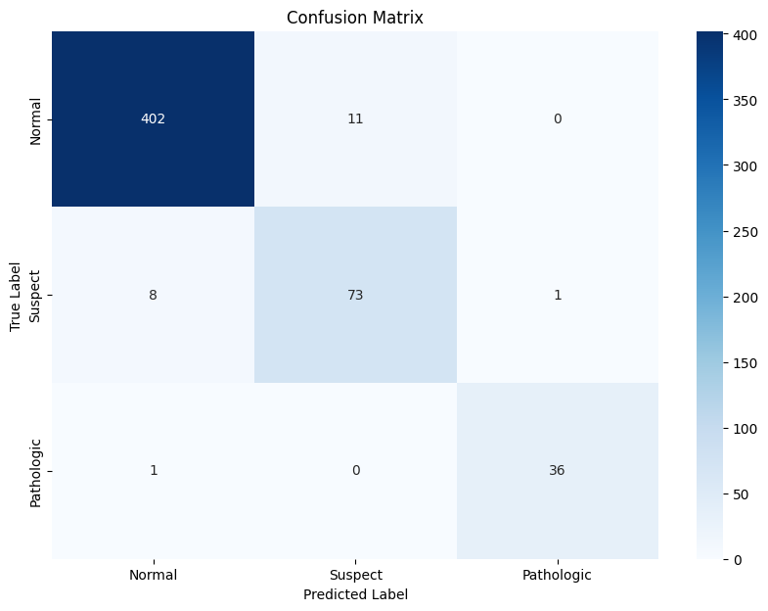
Model Performance
Scores between 0 and 1,
higher is better.
Class | Precision | Recall | F1-Score
Normal | 0.98 | 0.97 | 0.98
Suspect | 0.87 | 0.89 | 0.88
Pathologic | 0.97 | 0.97 | 0.97

Slide 10
Key findings
Good overall performance, correctly identifies all classes (high F1-score across all classes)
High recall (the most important performance metric for predicting fetal anomalies).
High recall means little false negatives, meaning that no suspect or pathological cases go unidentified.

Slide 11
Deployment and User Guide
Access the Service: Simply connect to the service locally through any web browser.
Input Data: Enter the patient’s data into the provided fields on the web interface.
Receive Classification: The service will classify the patient's condition as either Normal, Suspect, or Pathological.
Confidence Score: Along with the classification, a confidence score (ranging from 0 to 1) will be provided, indicating the model's certainty.
Low Confidence Alert: If the confidence score is low, the service will flag it, prompting the user to manually review and analyze the data carefully.

Slide 12
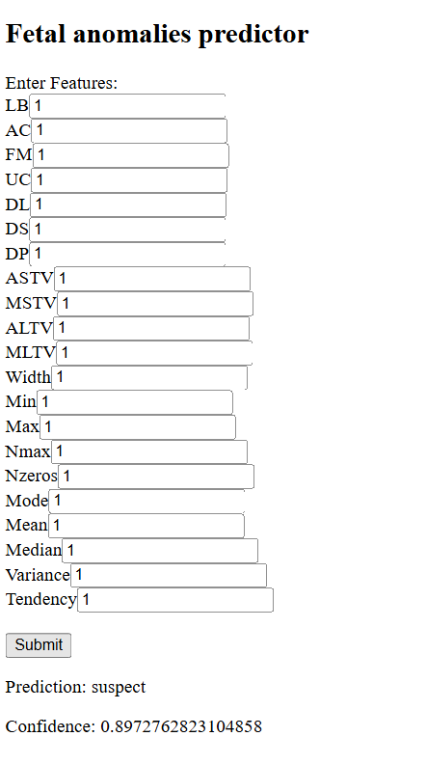
Example use

Slide 13
Conclusions
Outcome: Effective model for predicting fetal anomalies with high recall, easy to use web service.
Future Steps:
Fully-fledged web application (authentication, persistency, integration with other digital services).
Increase model performance and robustness:
Cross-validation
Expanded dataset
Ensemble methods
Feature engineering

Slide 14
Thank you for you attention!
Any questions?
Gian Luca Nediani, gianluca.nediani@icloud.com

